Slide 1

NAME: E.G.PRADEEP ROLL NO : RA2211004050026 DEP: B.TECH.ECE SUB: DESIGN THINKING METHODOLOGY SUB CODE : 21DCS201P

Slide 2
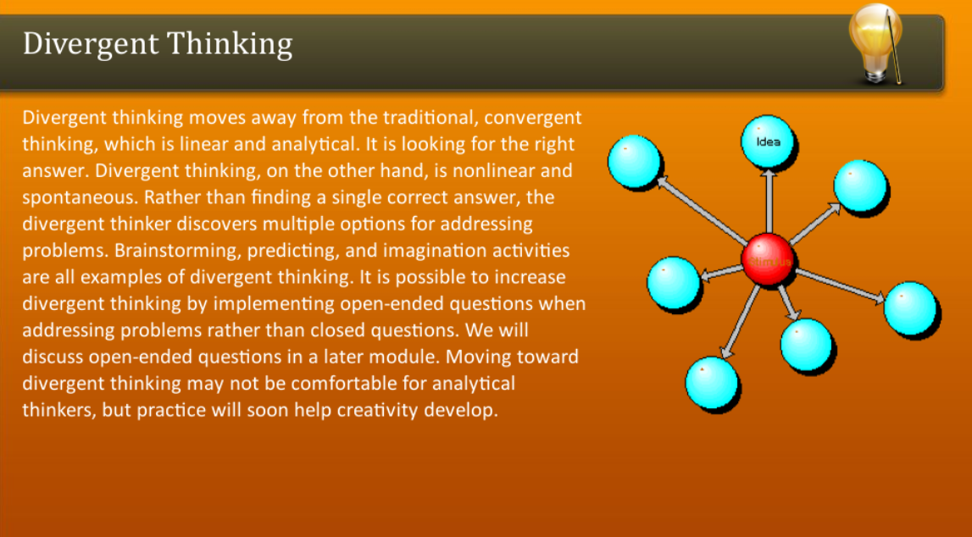

Slide 3
DIVERGENT THINKING TOOLS : Divergent thinking tools are techniques or methods used to stimulate creative and innovative thinking by encouraging the exploration of multiple possibilities and generating a wide range of ideas. Here are some common divergent thinking tools: 1.Brainstorming: A group technique where participants generate ideas freely and without judgment, aiming to produce a large quantity of ideas in a short amount of time. 2.Mind Mapping: A visual tool used to organize thoughts and ideas around a central concept, allowing for the exploration of connections and associations between different concepts. 3.SCAMPER: An acronym for Substitute, Combine, Adapt, Modify, Put to Another Use, Eliminate, and Reverse, which provides prompts to help generate new ideas by modifying existing ones. 4.Random Word or Picture Prompts: Introducing random words or images as stimuli to inspire new ideas and associations that may not have been considered otherwise. 5.Role-playing: Encouraging individuals to adopt different perspectives or personas to generate ideas from various viewpoints.

Slide 4
6.Reverse Thinking: Considering the opposite or reverse of conventional wisdom to provoke new insights and solutions. 7.Provocation: Introducing provocative statements or questions to challenge assumptions and stimulate unconventional thinking. 8.Analogies: Drawing parallels between unrelated concepts or domains to generate novel ideas. 9.Lotus Blossom Technique: A structured brainstorming method that involves systematically expanding upon a central idea by exploring its various components and associations. 10.Free Writing: A technique where individuals write continuously without stopping or censoring themselves, allowing for the exploration of ideas without judgment.

Slide 5
MAIN FEATURWES OF DIVERGENT THINKING : 1.IT IS FREE FLOWING CHAIN OF IDEAS. 2.IT HAPPENS IN NON-LINEAR MANNER ,AS IT IS DOES NOT FOLLOW ANY PARTICULAR SEQUENCE OF THINKING. 3.MULTIPLE IDEAS CAN EMERGE AT THE SAME TIME,RATHER THAN ONE IDEA COMING UP ONLY AFTER THE OTHER HAS OCCURED. 4.NON-LINEAR ALSO MEANS THAT MULTIPLE SOLUTIONS ARE THOUGHT OF AND EXPLORED AT THE SAME TIME. 5.THIS HAPPENS IN A VERY SHORT AMOUNT OF TIMEAND UNEXPECTED CONNECTIONS

Slide 6
THANK YOU

